Slide 1
Netflix in 2011
Study Case Report

Slide 2

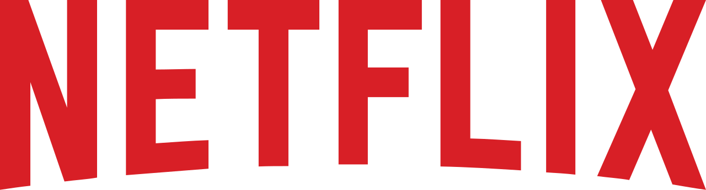
Introduction
Netflix was founded by Reed Hastings, and although it is one of the most successful streaming companies nowadays, it all started, in 1997, as a competitor of Blockbuster by distributing movies by mail that were ordered online.
In this presentation we will study the evolution of Netflix over time and compare it to its main competitor in the early days. In addition to this, we will also make some recommendations near the end.

Slide 3

Problem Identification
The problem we identified is if the splitting of Netflix DVD-by-mail and Netflix streaming was a good option.
To answer this, we will analyse all the information given and read some more articles from the same year from when the case was published (2011), both from Netflix and from the competitor company, Blockbuster.

Slide 4
How would you characterize Netflix’s business model for DVD-by-mail business?
1

Slide 5
Netflix DVD-by-mail Business Model Canvas
Key Partners U.S. Postal Service (USPS) - the USPS helped Netflix with the distribution of DVDs by mail - Netflix was USPS's fastest growing first-class customer Movie Distributors - In the beginning, Netflix filled its film library through a small number of distributors Small and Independent Film Studios - Netflix became their main distribution channel |  | Key Activities - Development of the Proprietary Recommendation System; - Building the Film Library; - Customer Retention; | Value Propositions - Proprietary recommendation system; - Mail Delivered DVDs - Subscribers can keep 3 movies at a time; - Subscribers can exchange DVDs as frequently as they liked. - Efficiency in mailing the DVDs; - The product is new (DVDs hadn't been around for long) - DVD recommendations are always personalised to the customer |  | Customer Relationship Customers could unsubscribe online from Netflix as easily as they had been able to join. | Customer Segments - Mass market - Film enjoyers
 |  | Key Resources - Distribution Center for storing the DVDs; - IT infrastructures for the website and database; - Recommendation Algorithm; - Film Library |  |  | Channels - DVDs were distributed by mail (through USPS) - Rentals were done through a website
Cost Structure - $100 to $200 customer acquisition cost - Top film releases were the most expensive to buy, while smaller films were cheaper - $60000 to convert an existing warehouse to Netflix's needs - Initially, $18-$20 per DVD, which was later converted into a smaller upfront cost, but studios would receive a fee based on the title's total number of rentings |  |  |  | Revenue Streams - In the beginning, $4 per movie rented + $2 for shipping and handling + extended rental fees if the movie was not returned in time - Moved to a subscription model in 1999 and removed the extended rental fees -> customers would receive 4 new films each month - Soon changed its pricing model again and allowed customers to rent unlimited films. They could keep up to 3 films at home and exchange them as frequently as they wanted - Subscription plans ranging from $8.99 (only one movie at a time) and $23.99 (up to 4 movies at a time)

Slide 6
How would you characterize Blockbuster’s business model? And how would you characterize the differences between Blockbuster’s and Netflix’s DVD-by-mail business models?
2

Slide 7
Blockbuster Business Model Canvas
Key Partners Film Studios - Blockbuster would buy the films directly to the studios Dish Network acquired all the assets associated with BlockBuster in 2011 Hastings offered to sell Netflix to BlockBuster in 2000 for $50 million, but the deal was not accepted |  | Key Activities - Renting and selling films both in DVD and VHS format | Value Propositions - High variety of titles per store - 3$ to 4$ per rent - Rental period between two days and one week - Most people live within a 10-minute drive of a Blockbuster.” - High proximity to customers and high availability |  | Customer Relationship - Online/In-store promotions (renting movies online would give in-store coupons) - Customers could exchange DVDs both online and in store | Customer Segments - Mass market - Film enjoyers who don’t want to buy Dvds in order to watch films
 |  | Key Resources - Physical Stores for people to rent the movies - Physical Stores distributed evenly throughout the US - Large amount of hit movies |  |  | Channels - Physical Stores - Mail (but only later, not in the beginning)
Cost Structure - occupancy and payroll for staff members (10 per store + 1 manager) - Each store would purchase 100 copies of hit movies - Two inventory acquisition models: - purchase model: $15 to $18 per DVD, rent it 9-10 times, resell the DVD for $8 - revenue share model: $5 per DVD, rent it 9 times sharing 30% of the revenues with the studio, resell the DVD for $8 - $300k to set up a store |  |  |  | Revenue Streams - $3 to $4 dollars per rented movie + late fee if the movie was not returned in time - Late fees represented 10% of blockbuster's revenues - Newly released movies represented over 70% of total rentals - Later started offering a subscription service similar to Netflix's (started at $19.99, then was reduced to $17.49 and later to $14.99) without late fees

Slide 8
Blockbuster vs. Netflix DVD-by-mail
 | Blockbuster | Netflix DVD-by-mail
Operation Place | Physical Stores (later also mail) | Mail
Recommendations | Recommendations given in store by staff members | Personalized recommendations online
Revenues | Mostly from hit movies | More evenly distributed between hit movies and cheaper movies
Price / month | $9.99 - 1 DVD or Blu-Ray $14.99 - 2 DVDs or Blu-Ray | $7.99 - 1 DVD at a time $9.99 - 1 DVD or Blu-Ray Up to $43.99 - 8 DVDs
Online Streaming | Pay-per-view - films are rented for 24 hours for a certain price | Subscription plan - $7.99/month, unlimited access to Netflix films

Slide 9
How would you identify and explain the key changes in Netflix business model over time? What were the consequences of those changes in the evolution of Netflix’s business?
3

Slide 10

1. Changing to a prepaid subscription plan and removing late fees
Turned the disadvantage of the long delivery time into having movies at home all the time (in the beginning, maximum of 4 movies), which was a key advantage compared to the competitor companies.

Slide 11
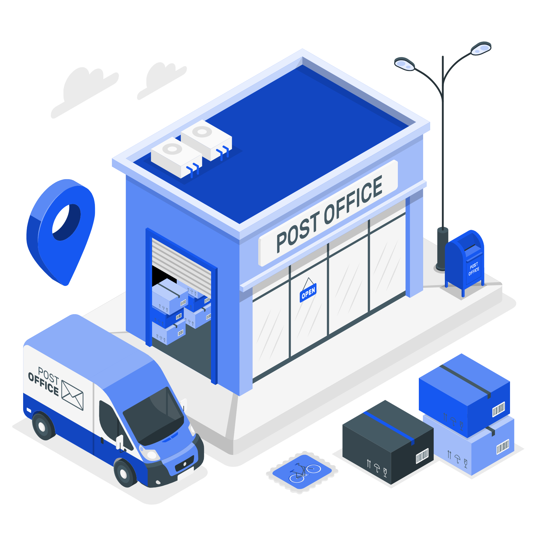
2. Adding distribution centers all across the country
Heavily reduced the time it took to ship, but mostly return DVDs.
Contributed to the great increase in Netflix subscribers in 2002.

Slide 12
3. Making the recommendation system personalized
When creating a new account, customers took a short survey to identify their favorite movie genres and rate specific movie titles.
The algorithm used these survey results and the respective ratings of millions of similar customers to recommend personalized choices for each user.
This new recommendation system filters the recommendations shown, so it doesn’t suggest movies that are out of stock.
Increased the utilization of movies already acquired and in stock, rather than requiring the purchase of more copies of newer films.

Slide 13

4. Streaming on-demand
This new service provided great content and personalization to the users. Furthermore, customers could also view Netflix’s content on their TV, instead of just on the computer.
Customers started shifting from DVDs to online streaming (in 2010, more people would watch shows and films through the streaming service than through DVDs)

Slide 14
How different would you say Netflix’s DVD-by-mail and streaming business models are? Does Netflix’s role change in streaming compared to DVD-by-mail?
4

Slide 15
Netflix DVD-by-mail vs. Streaming
The business models are similar in premise but different in the operation side of things. In both of the cases the client pays a subscription in order to be able to watch movies at home.
 | Netflix DVD-by-mail | Netflix Streaming
Client Access to Movies | Only access to 3 movies at a time and has to wait for the movie to come in the mail | Instant access to all the movies available on the platform
Infrastructure | Big physical infrastructure, including distribution centers and warehouses | Doesn’t require such a big physical infrastructure, but needs a huge cloud backend
Employees | to package and ship the DVDs | to work on developing Netflix’s online platforms (higher qualifications)
The role doesn't change in streaming compared to DVD-by-mail because Netflix continues to be a distributor. But Netflix gains one more role in streaming, it is also a creator of content.

Slide 16
Did Reed Hastings make the right move in trying to separate the DVD-by-mail business from the streaming business? How do you think he should proceed now?
5

Slide 17
Splitting the company- right move?
Different Operations
Different Technologies
Streaming and DVD require different infrastructures
One technology will probably take over the other
YES
Different Customer Base
Different Branding
Streaming and DVD appeal to different customers
Each company has its own selling points

Slide 18

Recommendations
Invest in deals with entertainment companies;
Improve the online streaming platform
Make more original content in order to gain and keep customers;
Continue investment into the DVD-by-mail since it’s the main profit origin
Slowly transfer investments into prominent technology

Slide 19
Thanks
Class 3, Group 4
Beatriz Mendes, up201806551@edu.fe.up.pt
Bernardo Ramalho, up201704334@edu.fe.up.pt
Pedro Azevedo, up201806728@edu.fe.up.pt
Pedro Ponte, up201809694@edu.fe.up.pt
Tomás Fontes, up201806252@edu.fe.up.pt

